Slide 1
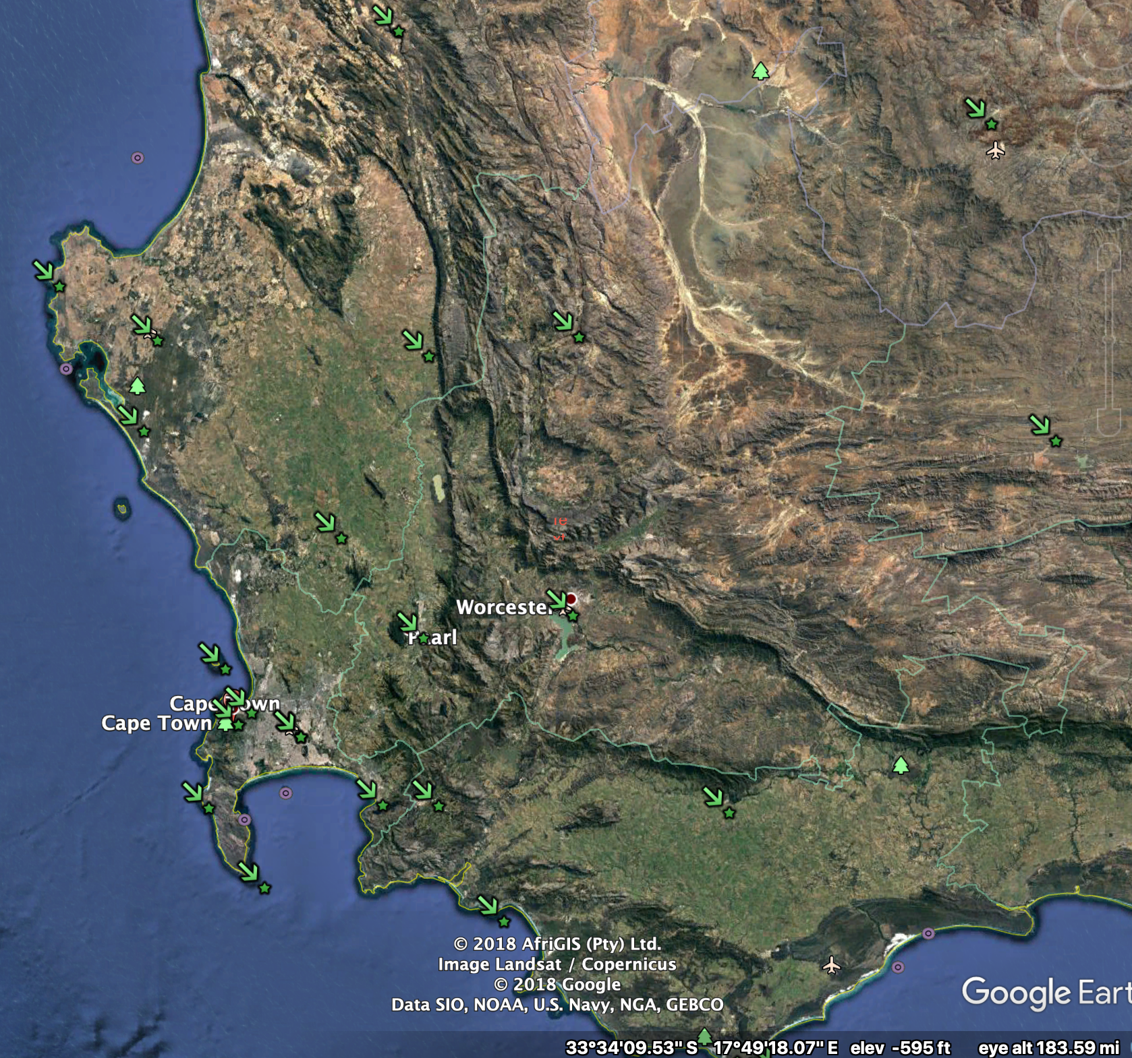
Porterville
Malmesbury
CT-AWS
Strand

Slide 2
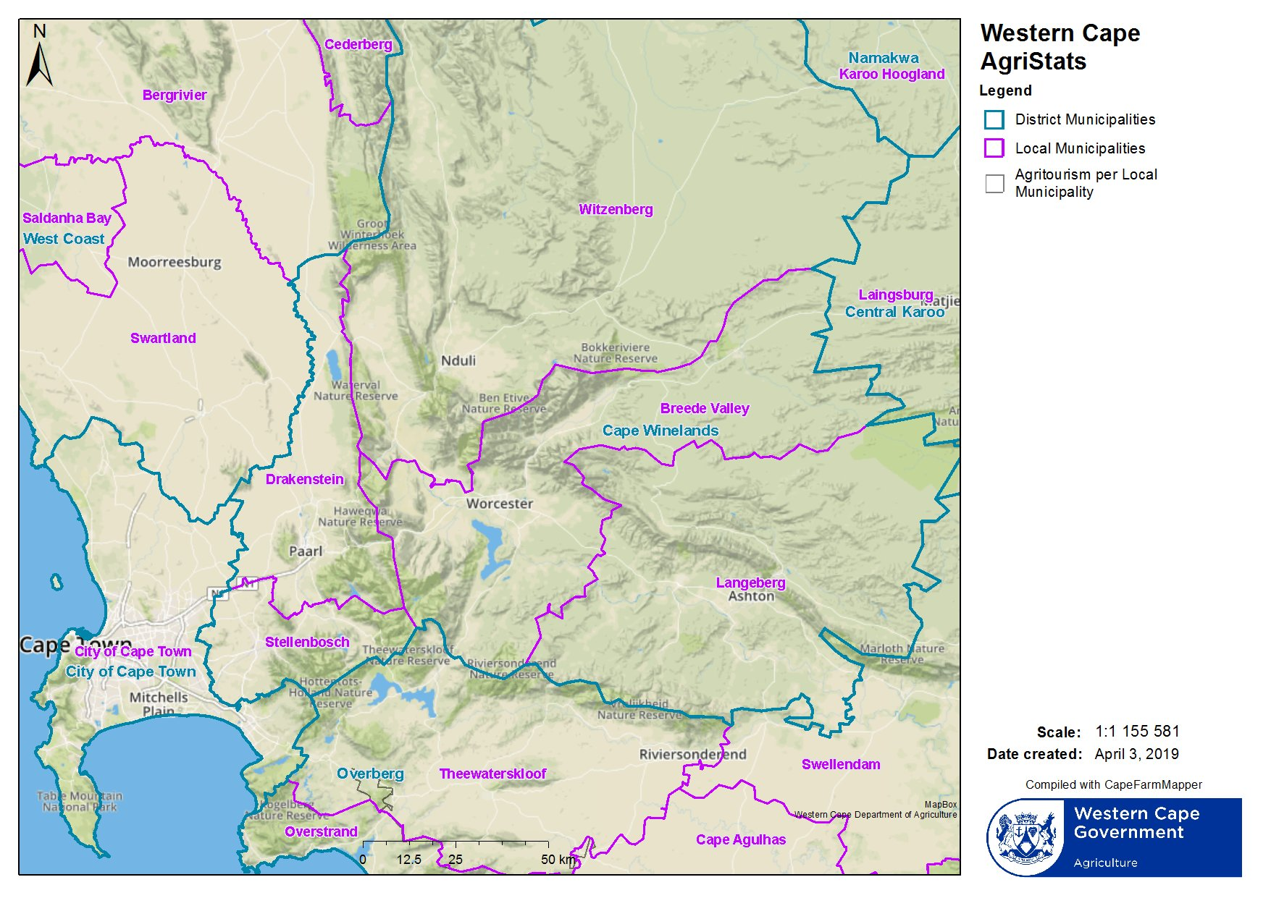
Porterville
Malmesbury
Worcester
Paarl
CT-AWS

Slide 3
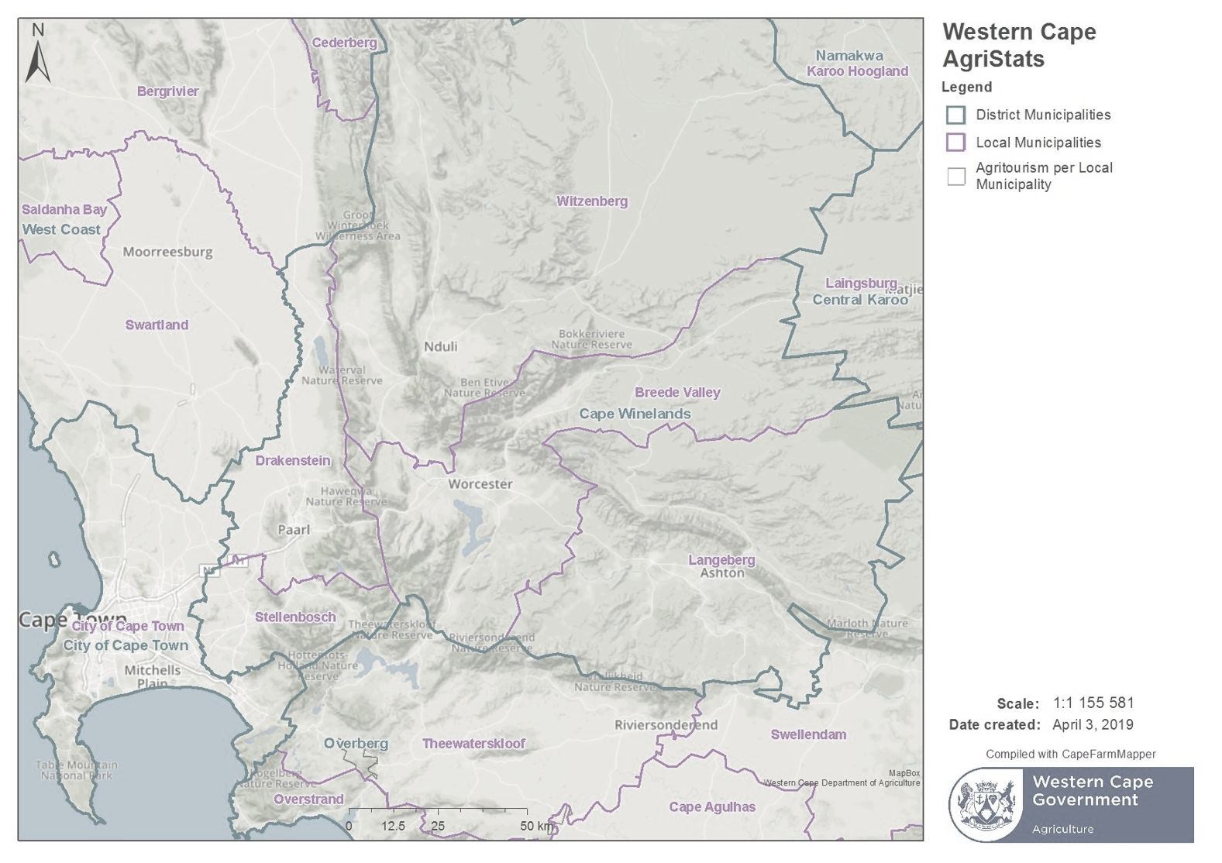
Porterville
Malmesbury
Worcester
Paarl
CT-AWS

